Slide 1
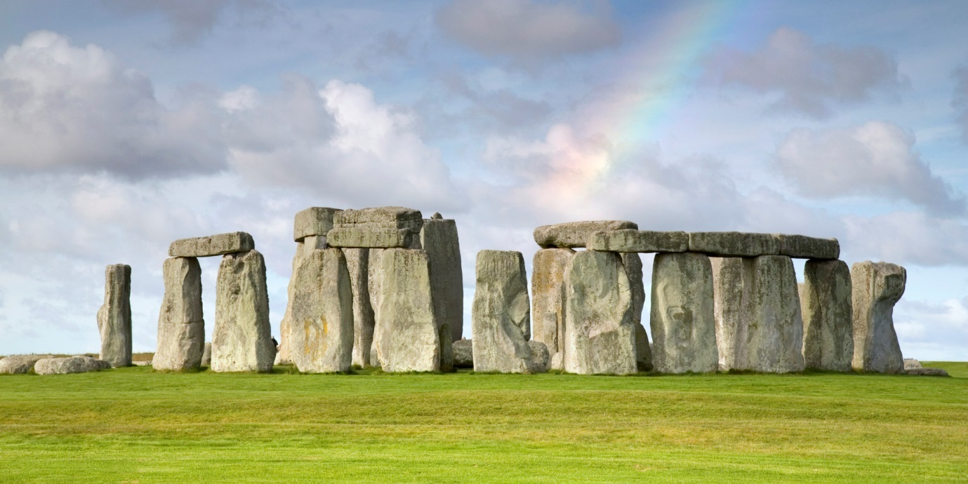
SURVIVAL OF THE FITTEST
K. HARIHARAN
MAHINDRA ECOLE CENTRALE

Slide 2
SE 101 SURVIVAL OF THE FITTEST
How did Arts and Culture play such an important role until the dawn of Intelligence?
Understanding the World and surviving the odds required a way of Narrativising their own conflicts and dilemmas in order to seek solutions.
The Art of Exaggeration and Minimization
Which were the prominent areas?

Slide 3
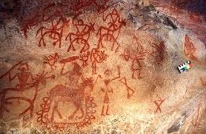
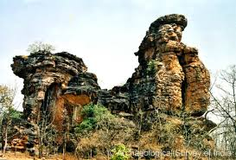
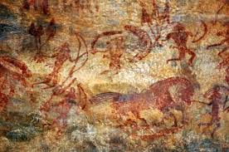
SE 101 SURVIVAL OF THE FITTEST
Food
Hunting and fruit gathering
Controlling the Animal World
Developing stories of Valour and Courage

Slide 4
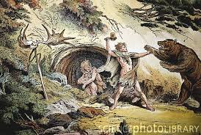
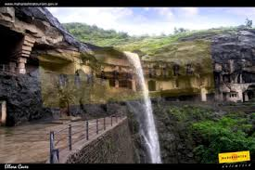
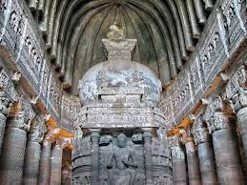
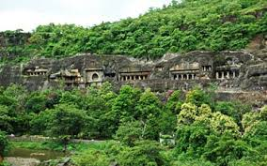
SE 101 SURVIVAL OF THE FITTEST
Shelter

Slide 5
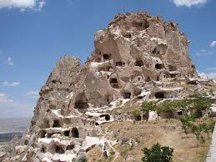
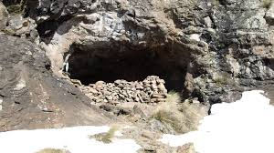
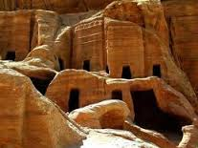
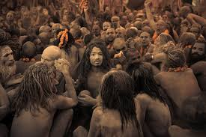
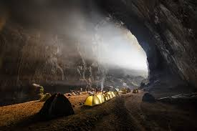
SE 101 SURVIVAL OF THE FITTEST

Slide 6
SE 101 SURVIVAL OF THE FITTEST
Understanding Nature
The Vedic World and its recitations
The Greek World and its stories
The Egyptian World and Order
The Chinese World of Conservation
Various tribes spread across the world and what was the way they understood what was Real and what was Not?

Slide 7
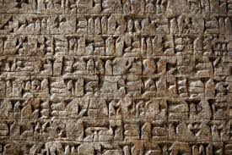
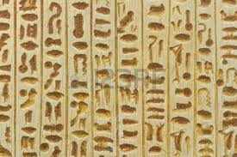
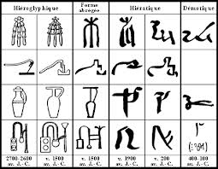
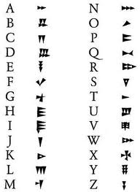
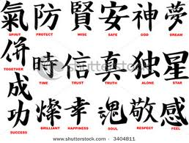
SE 101 SURVIVAL OF THE FITTEST
Languages play a serious role

Slide 8
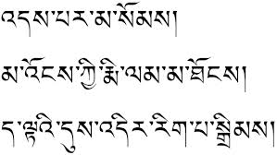
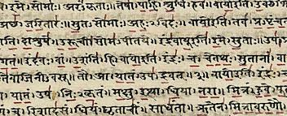
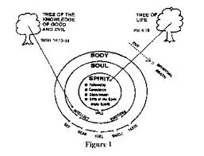
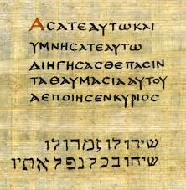
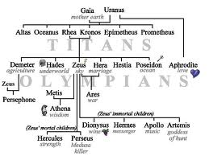
Languages express more

Slide 9
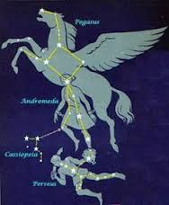
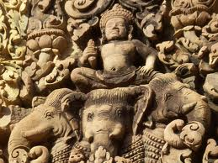

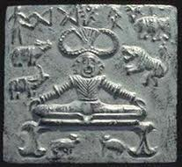

SE 101 SURVIVAL OF THE FITTEST
Words and Images juxtapose to create newer meanings

Slide 10
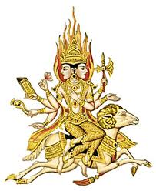
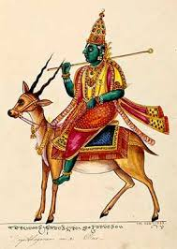
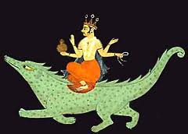
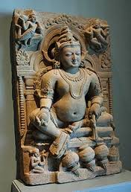
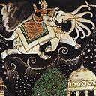
The Five Elemental Deities

Slide 11
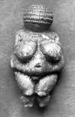
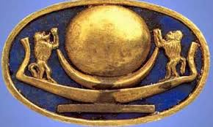
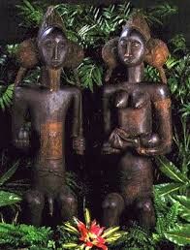
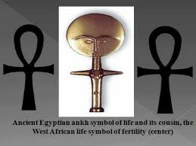
SE 101 SURVIVAL OF THE FITTEST
THE CYCLE OF BIRTH AND DEATH

Slide 12
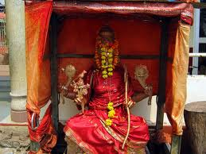
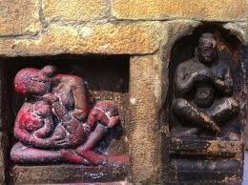
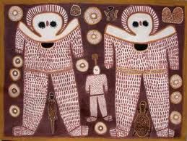
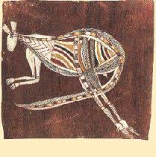

Slide 13

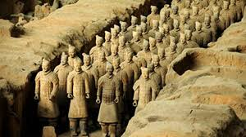
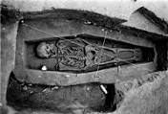
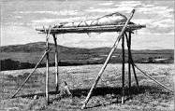
SE 101 SURVIVAL OF THE FITTEST
Dealing with Death

Slide 14
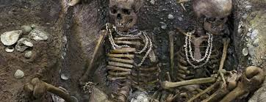
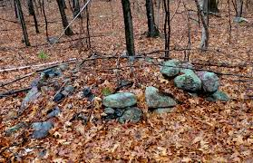
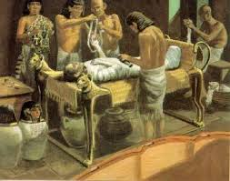
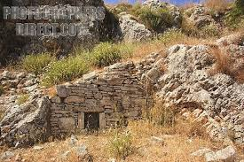

Slide 15
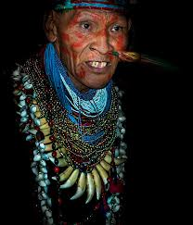
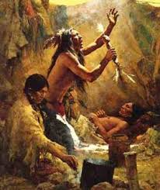
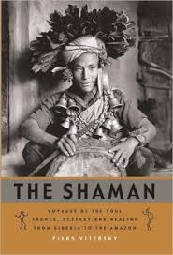
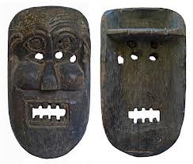
Se 101 SURVIVAL OF THE FITTEST
The world of Shamans or Soothsayers

Slide 16
SE 101 SURVIVAL OF THE FITTEST
Shamans act as intermediaries between humans and supernatural forces and function as social/spiritual healers providing remedies
What is storytelling and what are mythologies?
Storytelling is the art of stating about how Something Happened to Someone!
But not everything can be Narrated so easily!
Mythology is the art of Reconciling one’s Consciousness with one’s Existence

Slide 17






Slide 18



SE 101 SURVIVAL OF THE FITTEST
Are Shamans or Soothsayers relevant today?

Slide 19
SE 101 SURVIVAL OF THE FITTEST
Surviving through Ignorance was possible because of Scientific understanding, making the handling of Food Gathering, Shelter, Understanding Life Cycles and Dealing with the Elements reasonably easy
And through Arts and Culture evolved Language and other Art Forms which enabled Data to be preserved in ways which could be authentic and dynamic at the same time

Slide 20






Slide 21



SE 101 SURVIVAL OF THE FITTEST
Have the Shamans Really Gone?

Slide 22


Se 101 survival of the fittest
In what direction do we want the world to Change? Or

Slide 23

Can we bring back a World full of Peace and Understanding?

